Slide 1

MELODI
Music Social Media
Adrianna Bordonaro,
Zachary Sloan,
Cameron Catanzaro,
Giovanni Raia,
Harrison Weston
Notes:
All members of the class are expected to be able to present to the client. You all need to be able to stand up and present your
work in the future, so this project is good practice. Everyone should take advantage of the opportunity to highlight their work.
However, presentations are expected to be no more than 20 minutes long for each major subsystem / deliverable, so concise
presentations are also expected. Teams may be called in random order to give their final presentations as determined by the
instructor. A grading rubric for presentations is included in this syllabus.

Slide 2
AGENDA
01
02
03
04
05
06
INTRODUCTION
PLANNING & DESIGN
TECHNICAL SPECS
DEVELOPMENT PROCESS
REFLECTIONS
PROJECT DEMO
Notes:
Introduction, Planning & Design - Adrianna
Technical Specs - Cameron
Development Process - Gio
Reflections - Harrison
Demo - Zach

Slide 3
INTRODUCTION
01

Slide 4
TEAM ROLES
ADRIANNA
ZACARI
GIOVANNI
- Project Management, Planning & Requirements, UX/UI Design, Testing
-Backend APIs, Database Manager, Spotify APIs
- Carousel node modules, Spotify APIs, helped with Global Ranking and Suggested Playlists
HARRISON
CAMERON
-
Spotify API, Front End/UI/UX
-Input Sanitization, Multi-Factor Authentication, Gmail API, User data encryption
Notes:
everyone presents their own piece here

Slide 5
PLANNING & DESIGN
02

Slide 6
DOCUMENTS AND DIAGRAMS
REQUIREMENTS DOCUMENT
USE CASE DIAGRAM
Our starting point and reference for all development decisions and features
Helped us understand the users and how the application will be used
ER DIAGRAM
TIMELINE & TRACKING
Entity relationships (database layout) informed backend architecture
Used GitHub milestones to document and track each subset of requirements

Slide 7
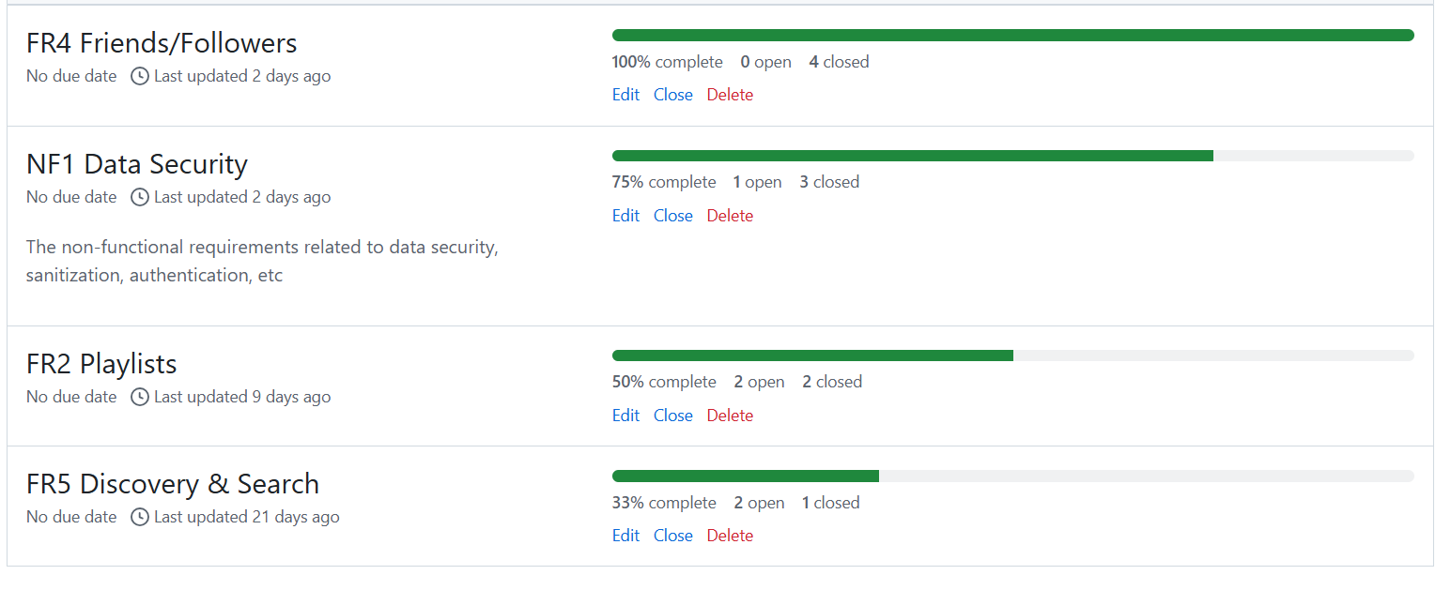
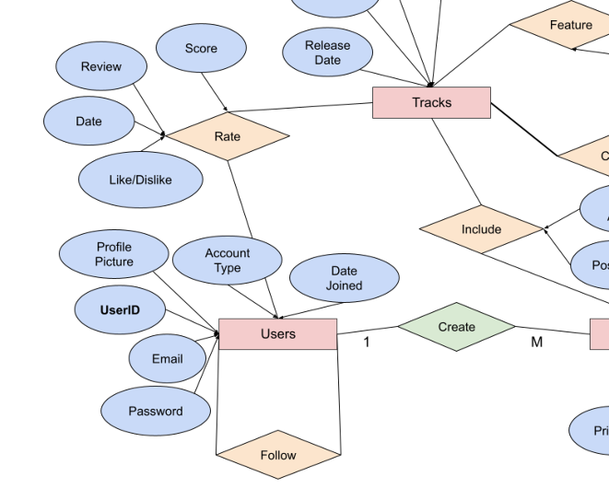
DOCUMENT EXAMPLES

Slide 8
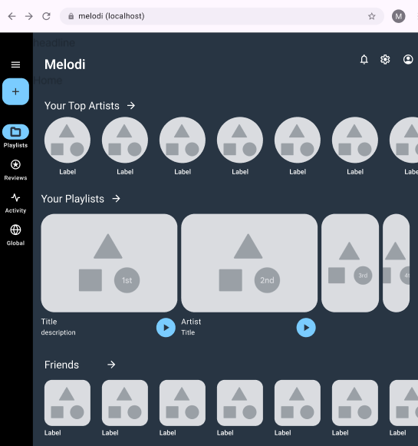
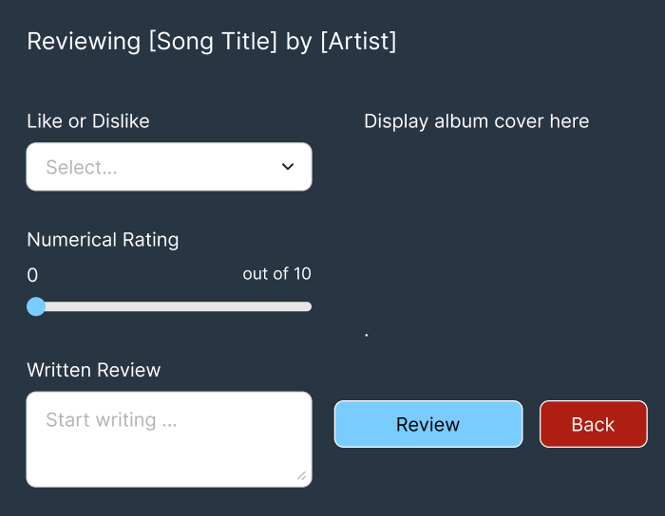
FIGMA WIREFRAME
UX/UI Draft

Slide 9
TECHNICAL SPECIFICATIONS
03

Slide 10
TOOLS AND ASSETS
NEXTJS
MONGODB
Dynamic, efficient web pages, Server Sessions, Next Auth(Login)
Scalable NoSQL database
GITHUB
AWS S3
Collaborative version control, requirements tracking, and project planning
Image storage, Pre Authenticated Url

Slide 11
APIS AND BACKEND
SPOTIFY API
GMAIL API
Track, artist, and genre data, user listening history, playlists
Two factor authentication
INPUT SANITIZATION
ENCRYPTION
Security feature to protect app and user data
User data is encrypted in transmission

Slide 12
DEVELOPMENT PROCESS
04

Slide 13
METHODOLOGY & PROCESSES
WEEK BY WEEK
SEMI-SYNCHRONOUS
MULTIPLE CHANNELS
Used the weekly class as our primary group meeting time and deadline for requirements, similar to an Agile sprint
Sometimes we worked in-person/simultaneously, sometimes not, depending on the task
Communicated in-person as well as over GitHub, Discord, and text messages

Slide 14
TIMELINE
REQUIREMENT / WEEK | 3 | 4 | 5 | 6 | 7 | 8 | 9 | 10 | 11 | 12 | 13 | 14 | 15
Diagrams & UX drafts
Backend (database, APIs)
Key features (user profiles)
Non-Functional
Additional features (likes)
Fine tuning

Slide 15
TESTING
TESTING AS WE GO
FORMAL TEST CASES
Included an “in review” section in our GitHub project plan and tested each feature before marking it complete.
Documented formal test cases for each requirement and recorded the outcome

Slide 16
REFLECTIONS
05

Slide 17
WHAT WENT WELL
COMMUNICATION
PLANNING AHEAD
TIMELINE
Our team communicated well and worked together effectively.
We got an early start on critical implementations (database and Spotify API), giving us plenty of time to work on them.
We stuck to our timeline and completed the project on schedule.

Slide 18
WHAT WE LEARNED
SCOPE
TOOLS
OVERALL LESSON
Initially, we included more features than we had time for. We re-evaluated and moved forward with more reasonable requirements.
The Spotify API was tricky to implement and required some specific workarounds.
Communicate, be flexible, adapt, play to team strengths, and be okay with your ideas being changed

Slide 19
PROJECT DEMO
06

Slide 20
THANKS!
Questions?

